Slide 1



NYC Taxi Trip Data ETL Pipeline (Kestra Orchestrated)
Presentation by
Sharon K Mungania
KawiraSharon

Slide 2
Tech Stack
Kestra Orchestration of the entire ETL pipeline. | Python Extraction, Transformation and Loading of data. | Docker Containerize PostgreSQL instance.
PgAdmin User Interface used to manage the PostgreSQL database. | Power BI Visualize the data using to provide meaningful insights. | GitHub Used as the version control and to host the entire codebase.

Slide 3
Project Context
This dataset provides an opportunity to practice core class concepts such as orchestration integration, docker containerization, and visualization.
It offers me an opportunity to restructure my project as well as resolve debugging challenges faced earlier on in the project execution.
This project implements an ETL pipeline orchestrated using Kestra. It extracts, transforms, and loads the dataset into a Dockerized instance of PostgreSQL database managed locally on pgAdmin, and visualizes key insights using Power BI.
The real-world data set has over 3M+ records, 19 columns.
Transformed: 2M+ records, Sampled: 20k records plus one derived column (trip_duration).

Slide 4
ETL Process Overview
3
1
2
Transformation
Loading
Extraction
Removal of ghost trips, timestamps are normalized, trip_duration added, trips > 3 hours removed.
Transformed data is loaded into a PostgreSQL database.
A table is created and the database can be accessed using pgAdmin.
Data is extracted using Kaggle from its API.
The .parquet is read using pyarrow + pandas.
Saved locally as nyc_taxi_data.csv

Slide 5
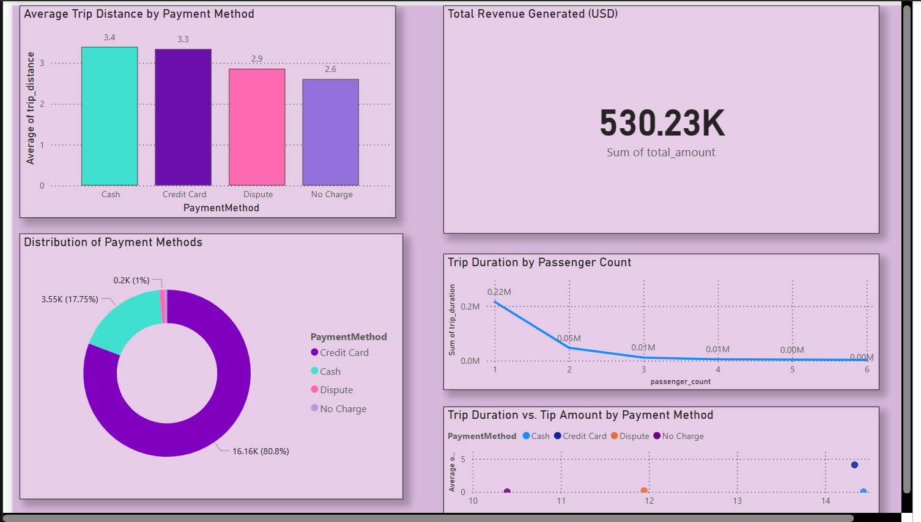

Star Schema
The Star Schema was used to generate Dimension and Fact tables, which were in turn used to visualize the data as seen on the Power BI dashboard as displayed above.

Slide 6


Challenges
Successes
Environment conflict with docker and vs code.
Scope creep.
Project was successfully restructured and moved from local conf to Kestra.
A solid understanding of all the tech tools used.
Future Improvements
Explore deeper learning of Kestra scheduling.
Research on tech tools before project initialization.

Slide 7
Video Demo

Slide 8
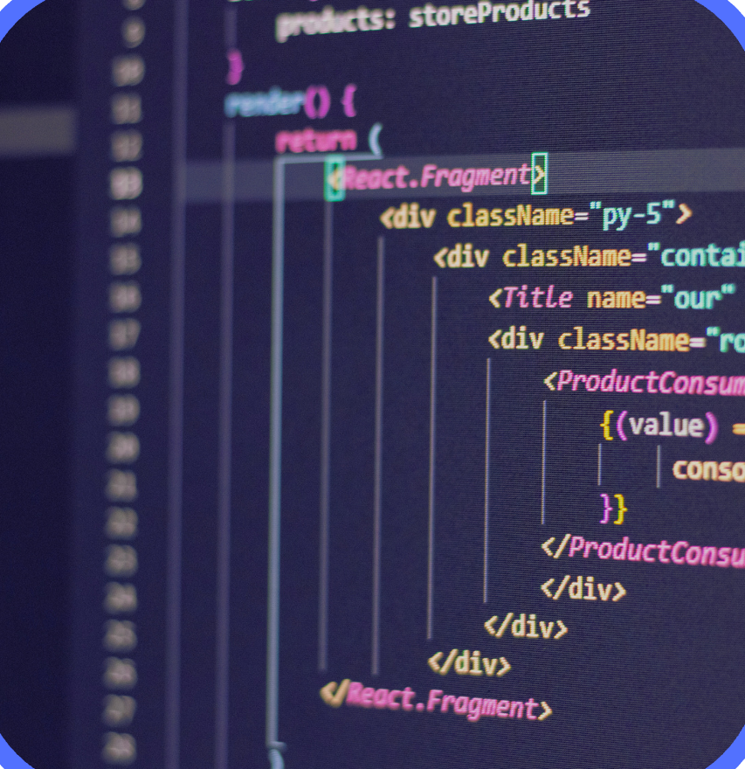
Thank you!
Sharon Kawira

